Slide 1
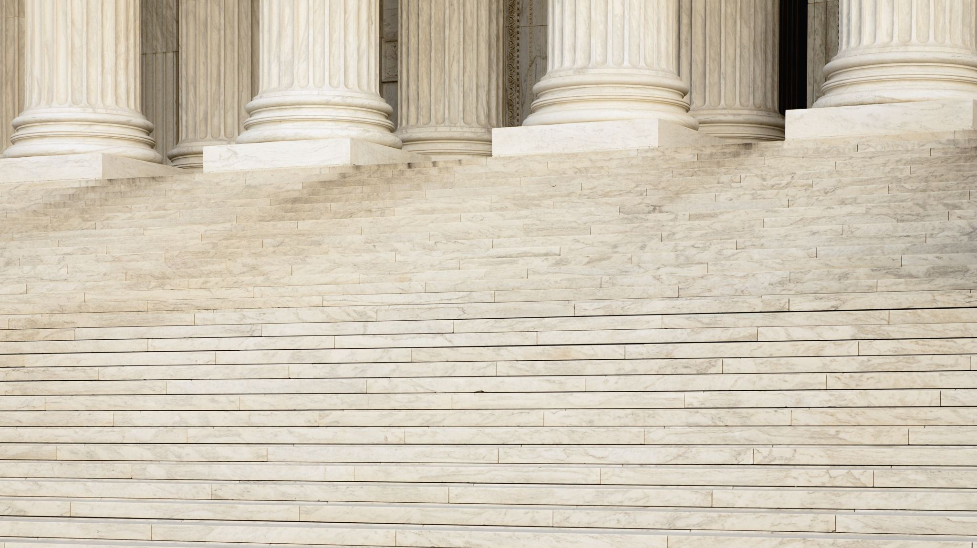
City of Laurens
MUNICIPAL JUSTICE COMPLEX

Slide 2
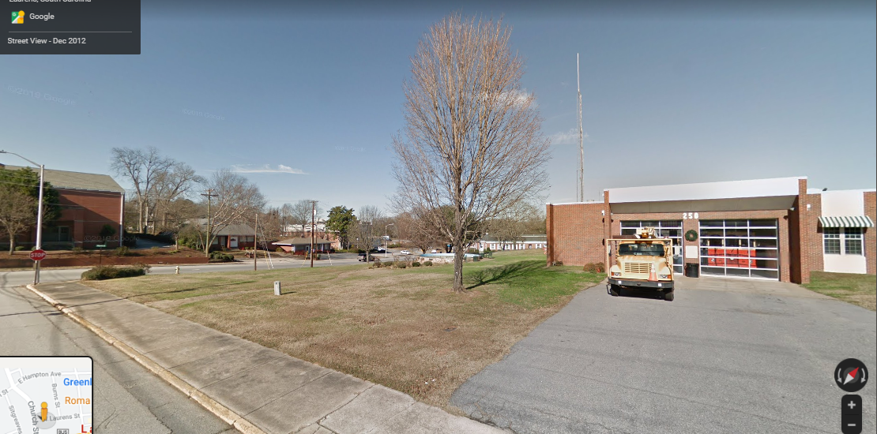

Slide 3
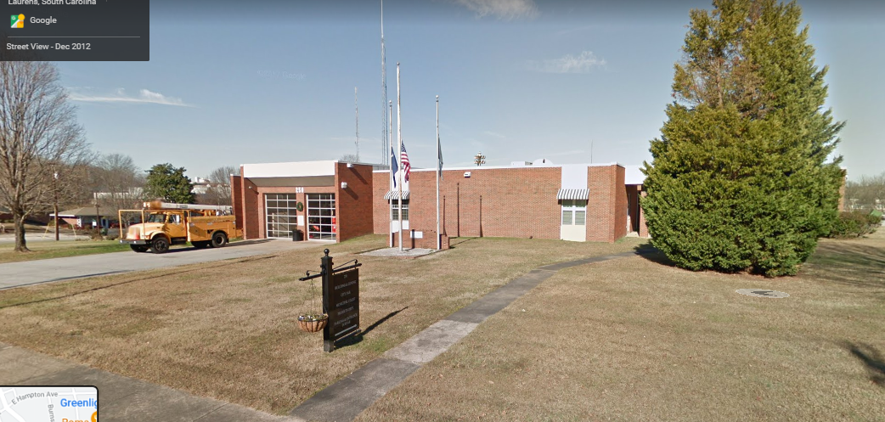

Slide 4
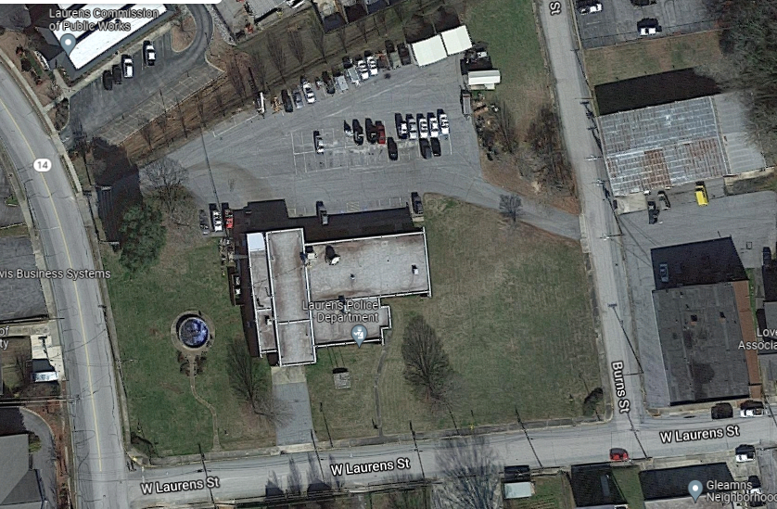

Slide 5
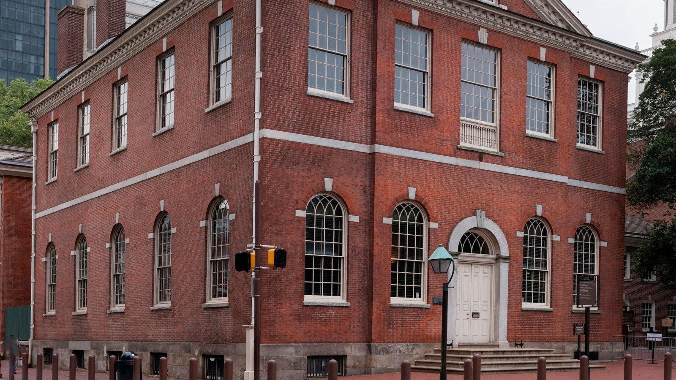
Old City Hall
Philadelphia, PA

Slide 6
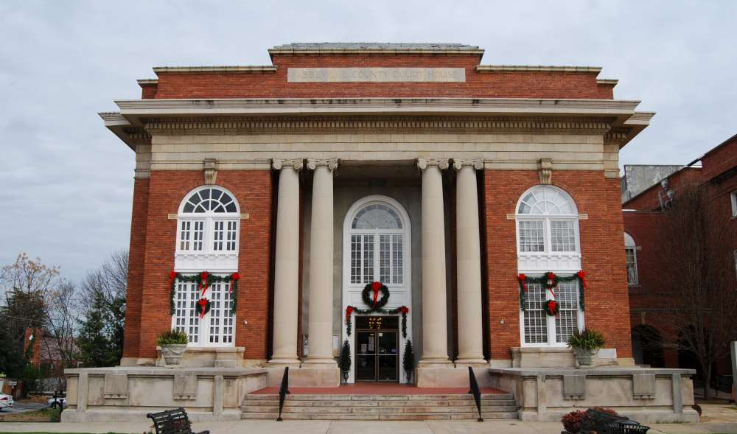
County Courthouse
Abbeville, SC

Slide 7
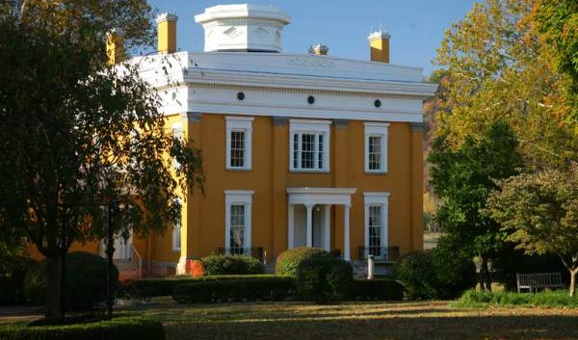

Slide 8
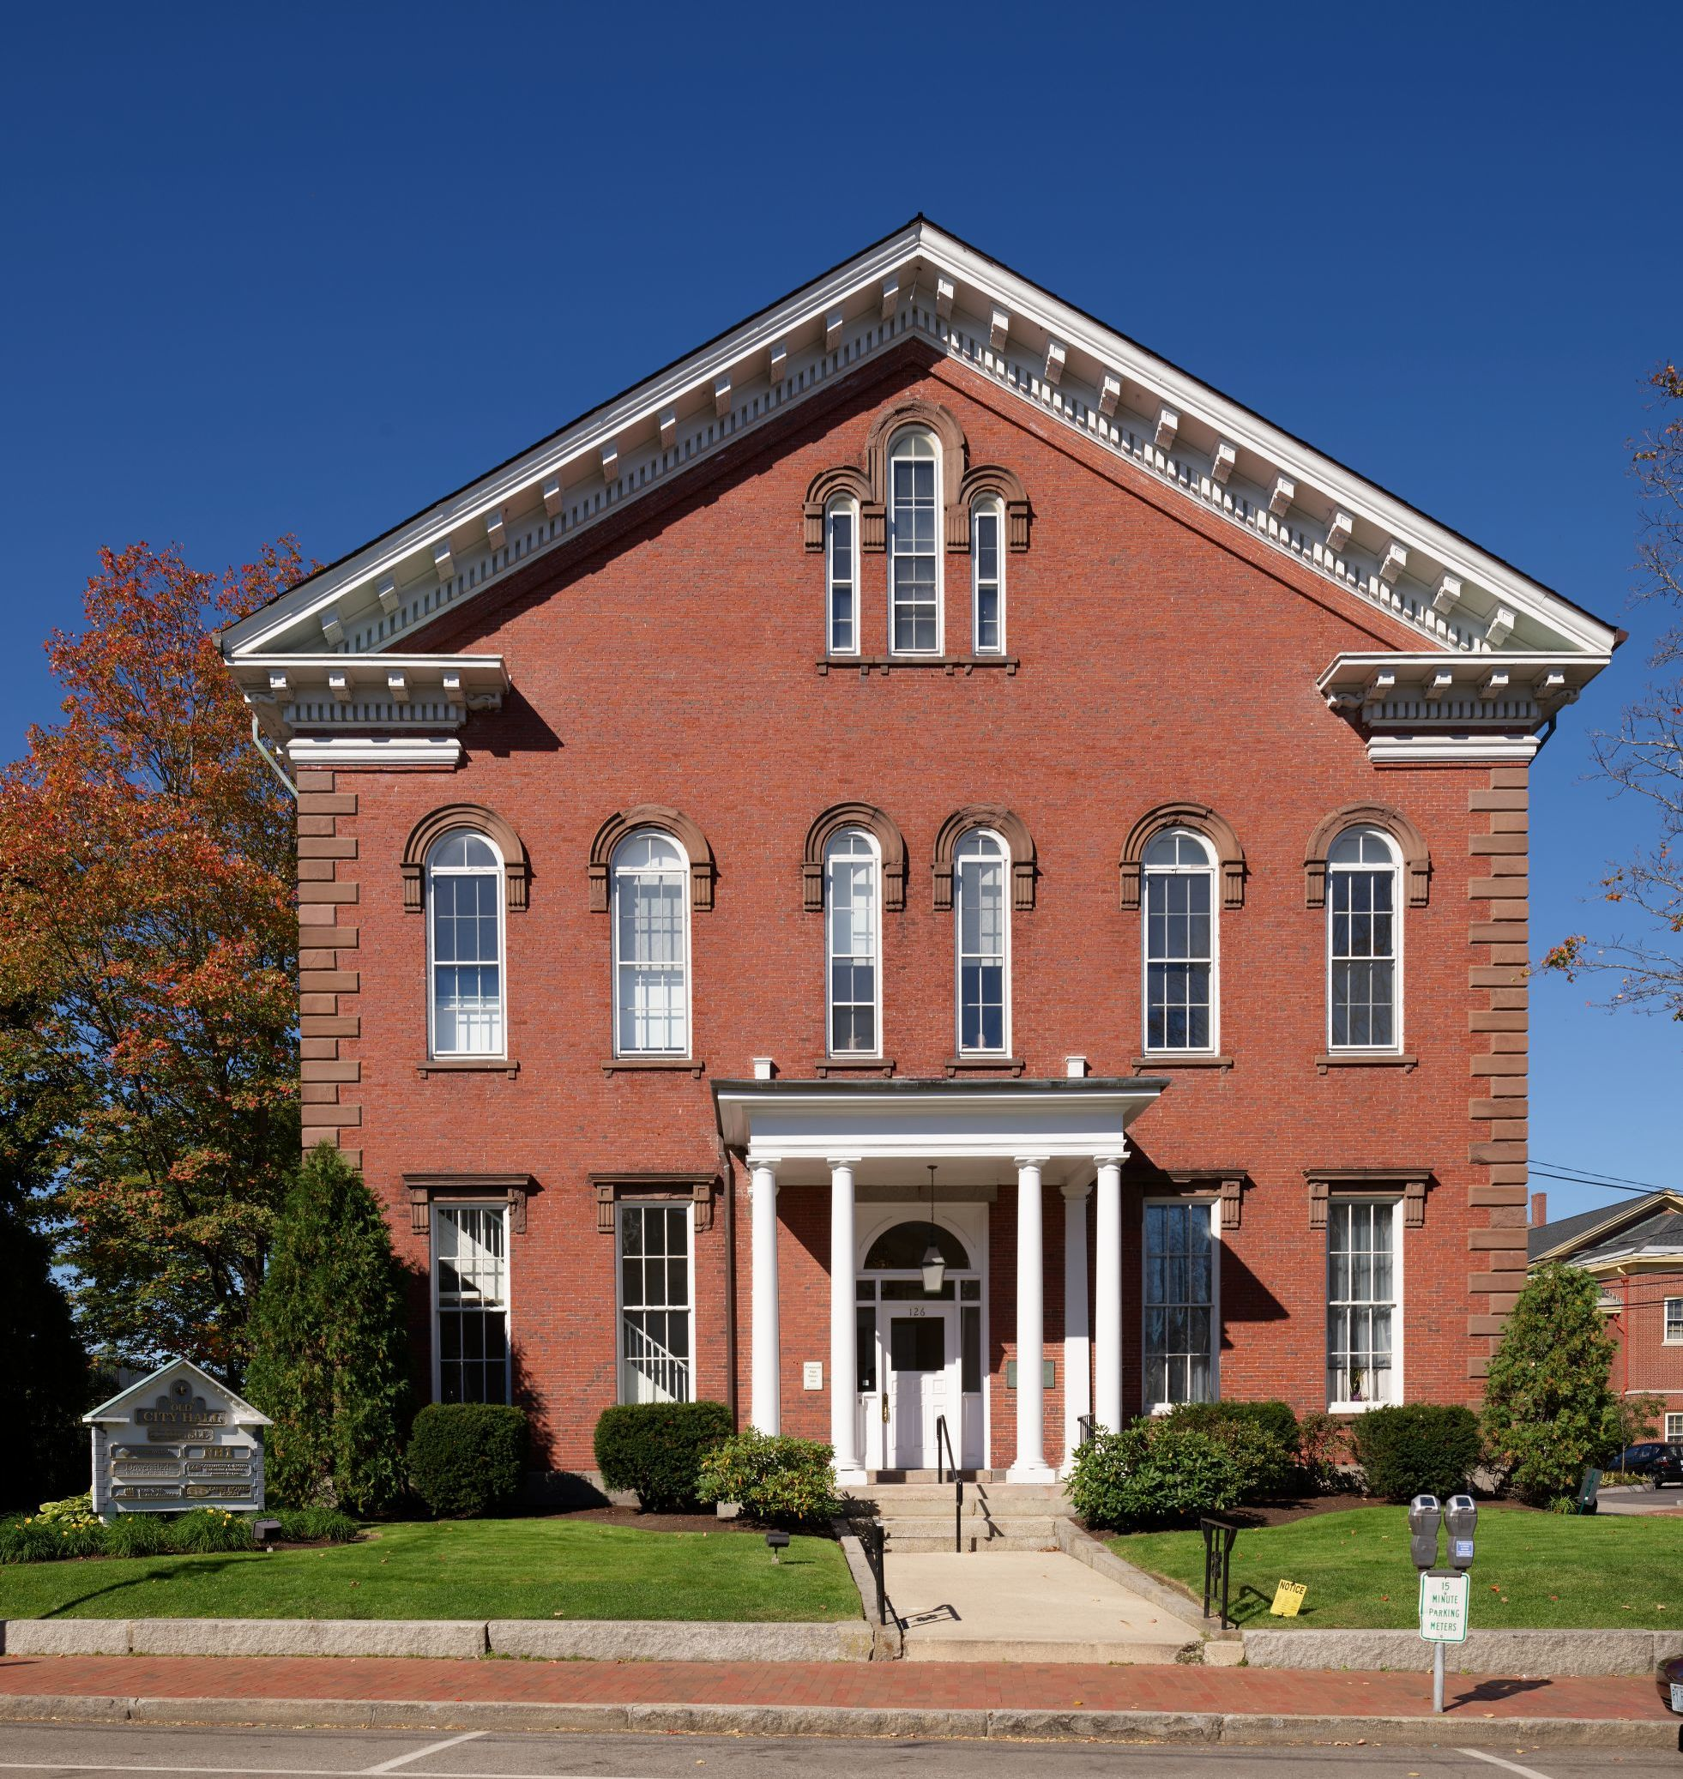
Old City Hall
Portsmouth, NH

Slide 9
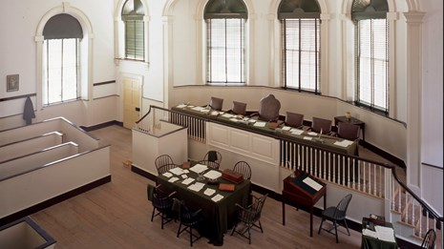
Old City Hall
Philadelphia, PA

Slide 10
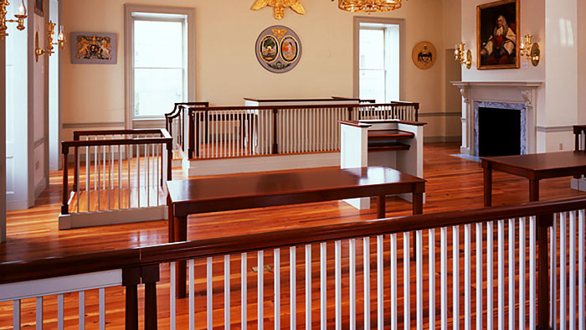
Charleston, SC

Slide 11
JUDICIAL WING

Slide 12
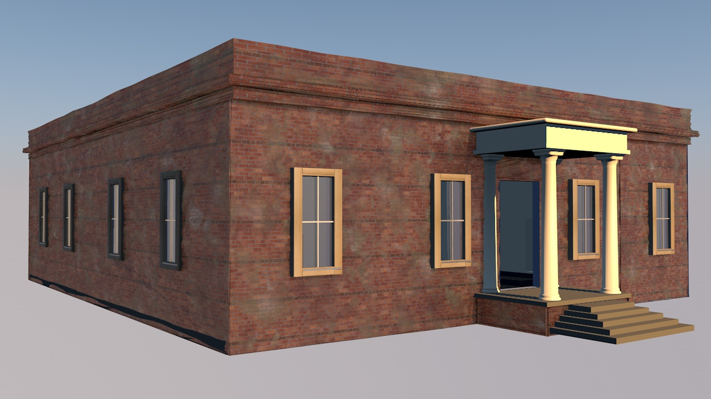

Slide 13
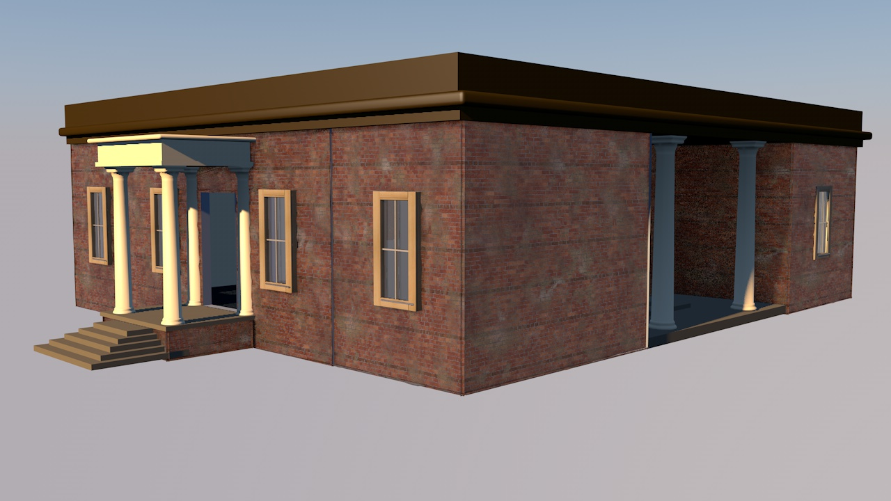

Slide 14
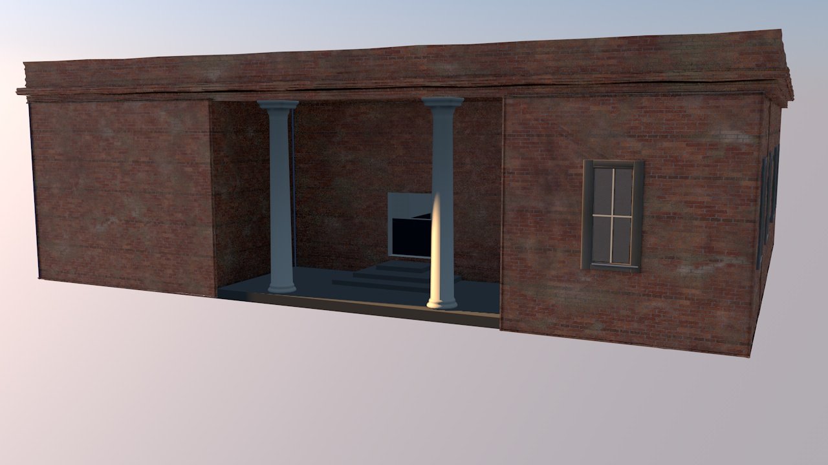

Slide 15
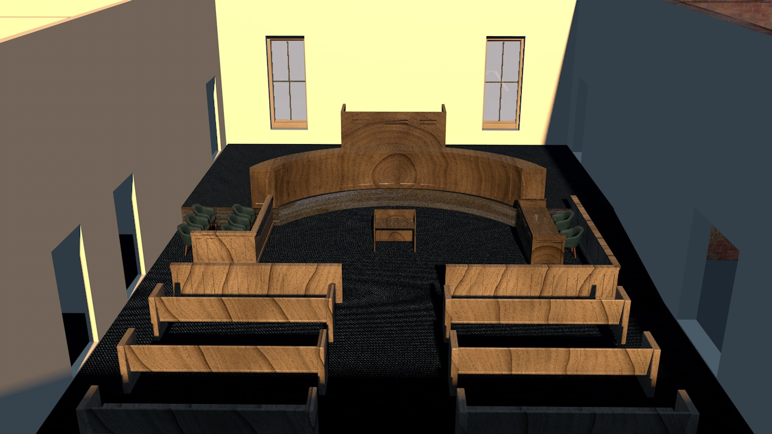

Slide 16
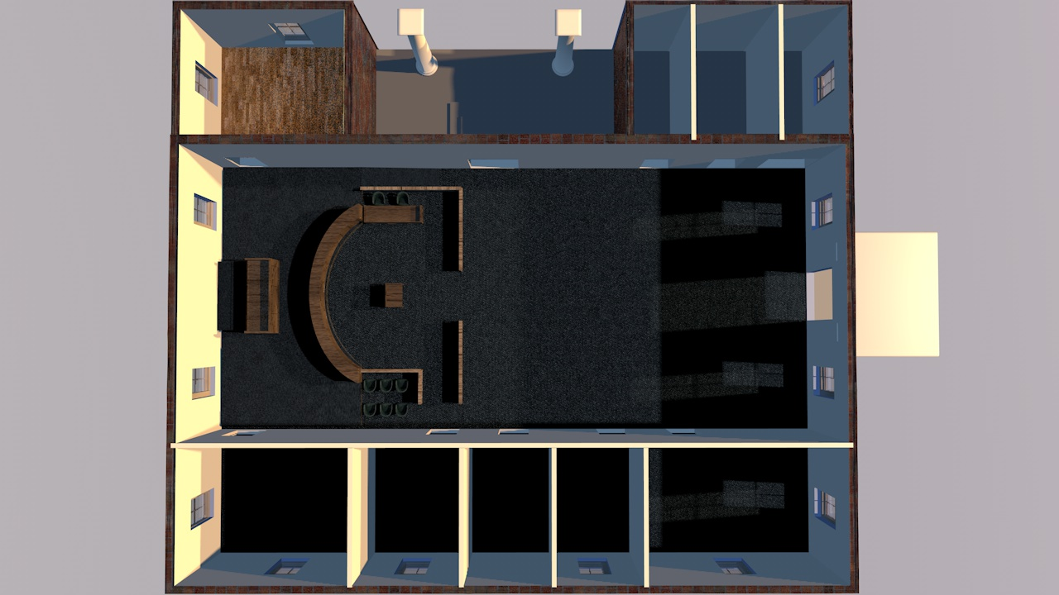

Slide 17
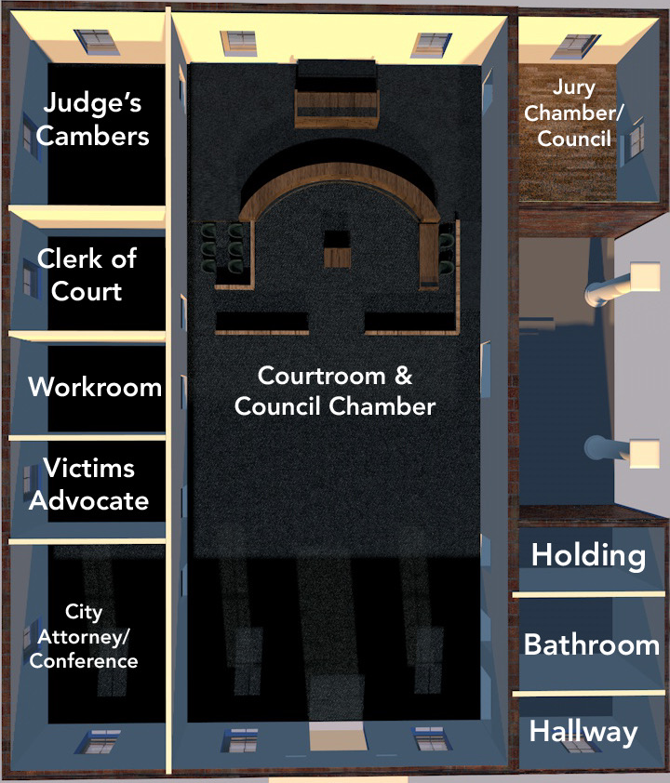
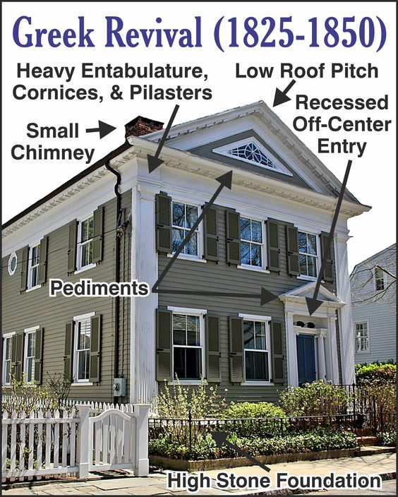

Slide 18
LAW ENFORCEMENT
WING

Slide 19
CENTRAL ENTRANCE

